Slide 1
GeoInsights: Regional Sales Analytics & BI Dashboard
2021–2024 Business Performance Analysis
Tech Stack:
Python | Pandas | Power BI | DAX
Prepared By - Rahul Kumar

Slide 2
Business Problem & Objective
Business Problem
Sales performance varies across products, channels, customers and geographic markets, making it difficult to identify the strongest revenue and profit drivers.
Objectives
Identify products, channels and regions driving revenue and profitability.
Detect seasonal patterns and transaction-value behavior.
Compare customer and state-level performance.
Identify pricing and margin patterns.
Build an interactive Power BI dashboard for decision-making.

Slide 3
Data Overview & Scope
Dataset Scope
Raw Excel Sources
Period analyzed: 2021–2024
Final transactions: 61,626
Products: 30
Customers: 175
Channels: Wholesale, Distributor, Export
Geographic coverage: U.S. states, cities and regions
Sales Orders
Customers
Products
Regions
State Regions
2024 Budgets

Slide 4
Data Wrangling & Quality Controls
Python/Pandas Processing
Loaded and profiled all source worksheets.
Validated missing values and duplicate records.
Standardized column names and data types.
Validated customer, product and geographic mappings.
Corrected 36 invalid 29-02-2023 dates using a documented end-of-February assumption.
Merged customer, product and geographic reference tables.
Removed redundant technical columns.
Restricted final analysis to 2021–2024.
The raw dataset contained 64,104 rows; the final analytical scope contains 61,626 transactions for 2021–2024.

Slide 5
Feature Engineering & Metric Logic
Engineered Features
Core Calculations
Year
Quarter
Month Name / Month Number
Total Cost
Profit
Profit Margin %
Total Cost = Quantity × Unit Cost
Profit = Revenue − Total Cost
Profit Margin % = Total Profit ÷ Total Revenue

Slide 6
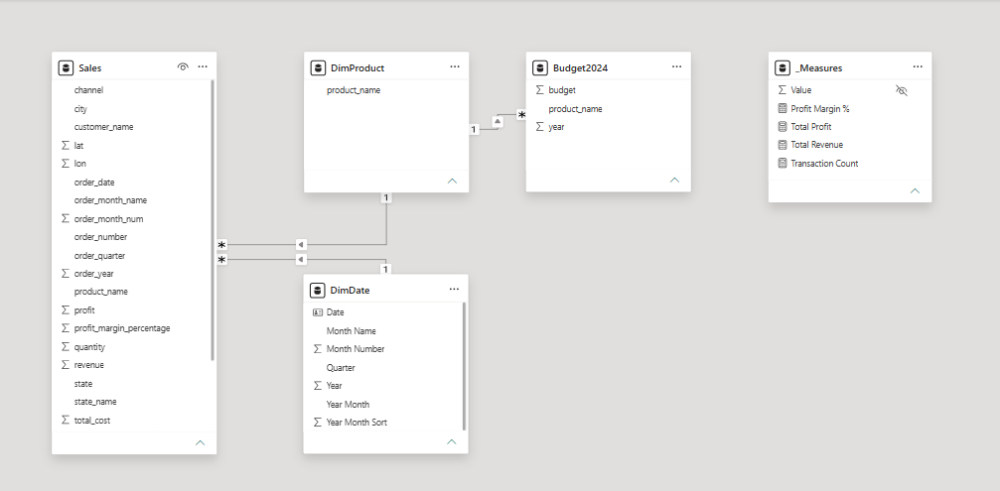
Power BI Data Model

Slide 7
Power BI Data Model
Core DAX Measures
Sales → main fact table
DimDate → time intelligence
DimProduct → common product dimension
Budget2024 → separate planning table
Single-direction relationships
Dedicated _Measures table for DAX measures
Total Revenue
Total Profit
Profit Margin %
Transaction Count
End-to-End Project Workflow
Excel → Pandas → Cleaning → Feature Engineering → Power BI Model → DAX → Dashboard → Insights

Slide 8
Dashboard Architecture
1. Overview
Title & Navigation hub
2. Executive Overview & Trends
Overall business health, seasonality and transaction behavior
3. Product & Channel Performance
Product rankings, profitability and channel contribution
4. Geographic & Customer Insights
Customer, state and regional performance

Slide 9
Executive Overview & Trends: Findings
KPIs
Total Revenue: $1.19B
Total Profit: $443.92M
Profit Margin: 37.37%
Transactions: 61,626
Monthly Revenue Seasonality
May records the strongest monthly revenue at approximately $102.27M.
February is the weakest at approximately $91.30M.
Revenue remains relatively stable during most other months.
Monthly Profit Contribution
Monthly profit contribution remains comparatively stable.
December contributes approximately $38.1M, among the strongest months.
Total profit reaches $443.92M.

Slide 10
Executive Overview & Trends: Findings
Transaction Value Distribution
Transactions are strongly concentrated in lower-value ranges.
Frequency declines as transaction value increases.
A long right tail indicates relatively few high-value transactions.
Average Unit Price vs Profit Margin
Most products cluster around 36–39% margins.
Pricing differences do not produce proportional margin differences.
Several products stand out as pricing/margin outliers worth investigating.

Slide 11
Product & Channel Performance: Findings
Top 10 Products by Revenue
Top 10 Products by Profit Margin
Product 26 leads with $112.45M.
Product 25 follows with $105.72M.
Products 26 and 25 are the strongest revenue contributors.
Product 9 leads at 40.12%.
Product 7 follows at approximately 38.82%.
Top product margins remain relatively close after Product 9.
Revenue vs Profit — Top Products
Products with higher revenue generally produce higher absolute profit.
Product 26 leads both revenue and profit among the displayed products

Slide 12
Product & Channel Performance: Findings
Profit Share by Channel
Revenue & Profit by Channel
Wholesale → approximately 53.59% of total profit
Distributor → 31.56%
Export → 14.85%
Wholesale: approximately $642M revenue / $238M profit
Distributor: $372M / $140M
Export: $173M / $66M
Profit Margin by Channel
Export → 38.03%
Distributor → 37.64%
Wholesale → 37.04%
Wholesale drives scale, while Export delivers the strongest margin efficiency.

Slide 13
Geographic & Customer Insights: Findings
Top 10 Customers by Revenue
Top 10 States by Revenue
Aibox Company leads at $12.16M.
State Ltd follows at $11.85M.
Pixoboo Corp contributes approximately $10.65M.
California dominates at $220.26M.
Illinois follows at $107.13M.
Florida: $87.01M
Texas: $80.77M
Top 10 Customers by Profit Margin
Neutrogena Ltd leads at 44.59%.
Avamba Company follows at 44.32%.
Amerisourc Corp reaches approximately 43.98%.

Slide 14
Geographic & Customer Insights: Findings
Revenue Share by U.S. Region
Profit Margin by U.S. Region
West → 30.14% / $357.99M
South → 27.08% / $321.67M
Midwest → 25.96% / $308.32M
Northeast → 16.83% / $199.85M
Midwest → 37.47%
West → 37.47%
South → 37.36%
Northeast → 37.06%
Regional margins are extremely similar, meaning regional revenue differences are driven primarily by scale rather than major profitability differences
Profit Distribution by State
California represents the largest state-level profit contribution.
Illinois and Florida form the next major profit contributors.
Profit is geographically concentrated among a relatively small group of leading states.

Slide 15
Key Business Insights
Seasonality: February is the weakest revenue month; May performs strongest.
Product: Product 26 leads revenue; Product 9 leads margin.
Channel: Wholesale delivers scale; Export delivers the highest margin.
Geography: West leads regional revenue and California dominates state performance.
Customer: Top-revenue and top-margin customers differ, creating targeted account-strategy opportunities.
Profitability: Margins remain relatively stable across channels and regions, so revenue growth depends strongly on scale, product mix and market penetration.
Risk
Top-10 customers contribute only about 8.84% of total revenue, indicating relatively diversified customer exposure.

Slide 16
Business Recommendations
1. Optimize Seasonal Planning
Strengthen promotions and pipeline activity around weaker February performance while preparing inventory/capacity for stronger months.
2. Prioritize Product Leaders
Protect Products 26 and 25 while studying Product 9's higher-margin characteristics for pricing/product-mix opportunities.
3. Balance Channel Strategy
Maintain Wholesale for scale while exploring profitable expansion opportunities in Export.
4. Expand Geographic Opportunities
Study the California/West playbook and identify transferable drivers for lower-revenue markets, particularly the Northeast.
5. Customer Growth Strategy
Retain top revenue accounts while targeting high-margin customers for cross-sell and upsell opportunities.

Slide 17
Project Outcome & Business Value
Converted fragmented multi-sheet Excel data into a validated analytical dataset.
Established correct transaction grain and financial calculations.
Developed a structured Power BI data model with reusable DAX measures.
Built three interactive analytical dashboards plus a navigation page.
Enabled analysis by Year, Product, Channel, Region and State.
Converted operational data into actionable product, channel, customer and geographic insights.

Slide 18
Conclusion
Conclusion
GeoInsights demonstrates an end-to-end analytics workflow—from data quality and feature engineering to dimensional modelling, DAX and interactive business intelligence.
Final takeaway:
The analysis identifies where revenue originates, which products and channels create value, how performance varies seasonally and geographically, and where management can focus future growth efforts.
Thank You
Questions?

